Slide 1
Calculating standard cell voltages
Bromfield AP Chemistry

Slide 2
A visual summary

Slide 3
_{Standard Reduction PotentiaLS}
A relative measure of tendency to undergo reduction
More positive Eº value (Higher up): greater tendency to reduce
Less positive Eº value (lower down): greater tendency to oxidize

Slide 4
Calculating E_{cell}
Find the half-reactions on the Table of Standard Reduction Potentials
The reaction that is higher on the table:
Greater tendency to reduce, so keep as written
This reaction will occur at the cathode

Slide 5
Calculating E_{cell}
Find the half-reactions on the Table of Standard Reduction Potentials
The reaction that is lower on the table:
Lesser tendency to reduce, so flip it to be an oxidation half reaction, change sign of Eº
This reaction will occur at the anode

Slide 6
Calculating E_{cell}
Find the half-reactions on the Table of Standard Reduction Potentials
The reaction that is higher on the table:
Greater tendency to reduce, so keep as written
The reaction that is lower on the table:
Lesser tendency to reduce, so FLIP it to be an oxidation half reaction, AND change sign of Eº
Add the Eº values to find E_{cell}

Slide 7
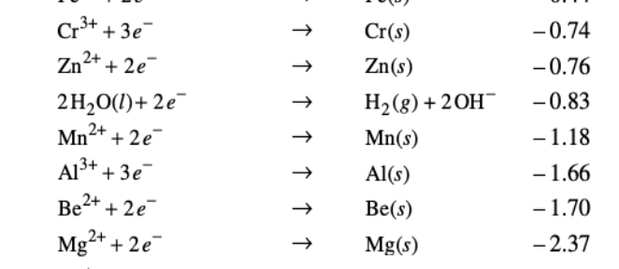
Calculate E_{cell}
keep
Cr⏐Cr³⁺⎪⎪Mg²⁺ ⏐Mg
Anode?
Cathode?
Balanced equation?
E_{cell}?
Mg
Cr
flip
Do not multiply Eº values by coefficients!
Cr³⁺ + 3e- ⟶ Cr
Eº = -0.74
Mg ⟶ Mg²⁺ + 2e-
Eº = +2.37
2 Cr³⁺ + 3 Mg ⟶ 3 Mg²⁺ + 2 Cr
$E_{cell }^{o}$= +1.63V

Slide 8
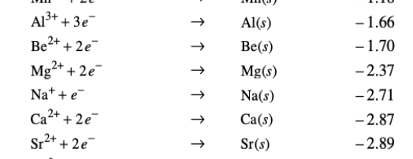
Calculate E_{cell}
Al⏐Al³⁺⎪⎪Sr ⏐Sr²⁺
Anode?
Cathode?
Balanced equation?
E_{cell}?
keep
Sr
Al
flip
Al³⁺ + 3 e- ⟶ Al
Eº = -1.66V
Sr ⟶ Sr²⁺ + 2 e-
Eº = +2.89 V
2 Al³⁺ + 3 Sr ⟶ 3 Sr²⁺ + 2 Al
$E_{cell }^{o}$= +1.23V

Slide 9
Another type of electrochemical cell
Electrolytic cells
Consume electrical energy to drive a chemical reaction
Electroplating

Slide 10
Galvanic vs. electrolytic cells
Galvanic Cells
Electrolytic Cells
Produce electrical energy
Occur spontaneously
E_{cell} > 0
Consume electrical energy
Non-spontaneous
E_{cell} < 0

Slide 11
Gibbs free energy & E_{cell}
$$∆G=−nℱE$$
n = number of electrons transferred
F = Faraday constant, $\frac{96500 coulombs}{mole e−}$

Slide 12
Gibbs free energy & E_{cell}
Voltaic cell
Electrolytic cell
Spontaneous
E_{cell} > 0
ΔG < 0
Nonspontaneous
E_{cell} < 0
ΔG > 0

Slide 13
Will the following reactions occur spontaneously?
Au + Pb²⁺ ⟶ Au³⁺ + Pb

Slide 14
Will the following reactions occur spontaneously?
Ni + Fe³⁺ ⟶ Fe²⁺ + Ni²⁺

Slide 15
Will the following reactions occur spontaneously?
Cu + Zn²⁺ ⟶ Zn + Cu²⁺

