Slide 1
Accuracy and Precision
Dr V’s Chemistry webcasts

Slide 2
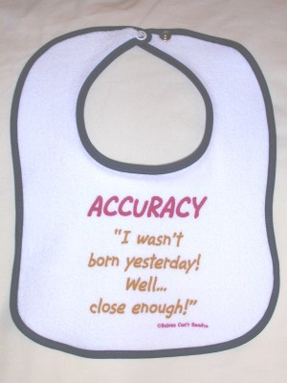
All measurements have an inherent error—instrument errors, method errors, or human error.

Slide 3
Systematic Errors
Built-in errors which consistently change all the measurements by a certain amount
Consistent and repeatable errors

Slide 4
Systematic Errors
Examples…
Finding length with a stretched out measuring tape (scale error)
Measuring your height with your shoes on (offset error)
Finding mass with an improperly zeroed or poorly calibrated balance

Slide 5
Random errors
Unpredictable, unknown variations
Limitations of instruments, tiny variations in the procedure
Examples
Changes in room temperature
Reading the volume from a graduated cylinder at different angles every time
Air currents affecting the mass readings on a balance

Slide 6
Accuracy
The extent to which a measurement approaches the true value of a quantity (from Chemistry: Visualizing Matter)
Accuracy is how close to the accepted or true value a measurement is. (from http://bell.mma.edu/~jbouch/Glossary/Accuracy.html)

Slide 7
Precision
The degree of exactness or refinement of a measurement (from Chemistry: Visualizing Matter)
The reproducibility of a particular measurement

Slide 8
Precision
Can be expressed using “significant figures”
Gives information on the scale markings of the measuring instrument
Smaller scale divisions ⇒ more significant figures ⇒ more precise

Slide 9
Precision
Precision measures how far from the mean or average of replicate measurements a particular measurement lies. (from http://bell.mma.edu/~jbouch/Glossary/Accuracy.html)

Slide 10
Range and precision
more precise
The range of measurements in a set is another way to discuss precision
Larger range → lower precision
Smaller range → improved precision
Experiment 1 | Mass of sample (g)
Trial A | 3.45
Trial B | 3.42
Trial C | 3.40
Range | 0.05
Experiment 2 | Mass of sample (g)
Trial X | 2.76
Trial Y | 3.87
Trial Z | 3.63
Range | 1.11

Slide 11
Good accuracy, good precision

Slide 12
Good accuracy, poor precision

Slide 13

Precise, but not accurate

Slide 14
Neither accurate nor precise

Slide 15
You and your classmates measure the length of your pencil in cm
Create sample data sets
Accurate, but imprecise
Precise, but inaccurate
Both accurate and precise
Inaccurate and imprecise
Take a screenshot of your answers and upload this for the assignment in Google Classroom

