Slide 1
Types of Chemical Bonds
Bromfield Honors Chemistry

Slide 2
3 classes of chemical bonds
How do valence electrons interact to form a bond?
Ionic bonds
Covalent bonds
Network covalent
Molecular covalent
Metallic bonds

Slide 3
Ionic Compounds
Involves a TRANSFER of electrons
Made from a metal & a nonmetal

Slide 4
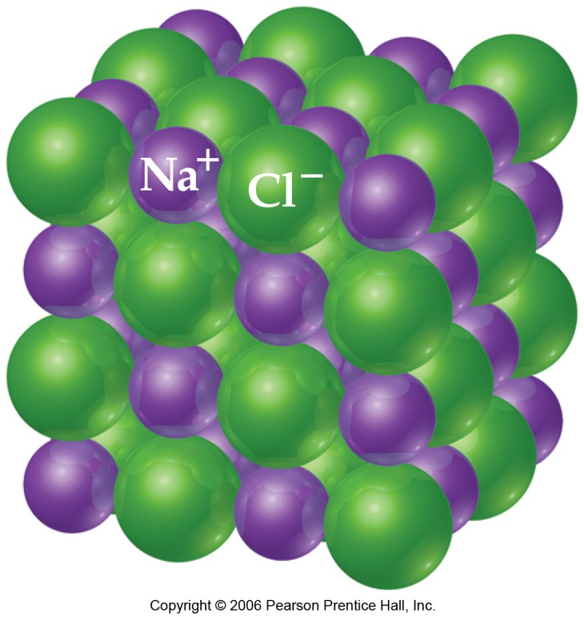
Ionic Compounds
Ionic solids exist as a 3D crystal lattice
Alternating positive and negative ions
Typically have high melting points and boiling points

Slide 5
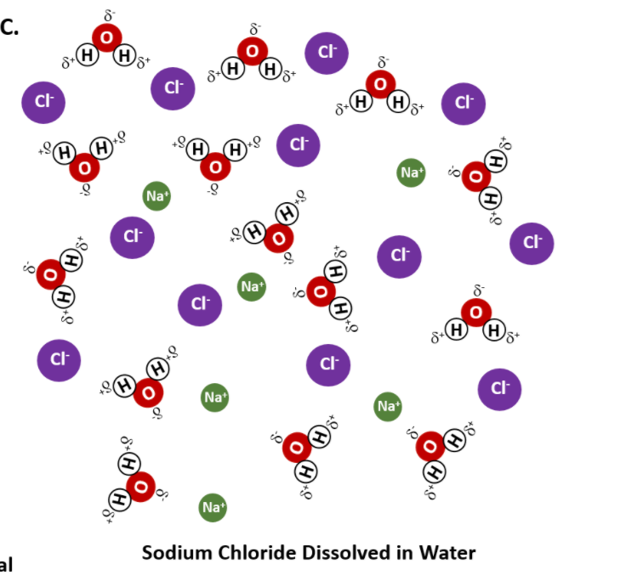
Ionic Compounds
Most ionic solids are soluble in water
Dissociate into ions in solution
NaCl(s) ⟶ Na⁺(aq) + Cl⁻(aq)

Slide 6
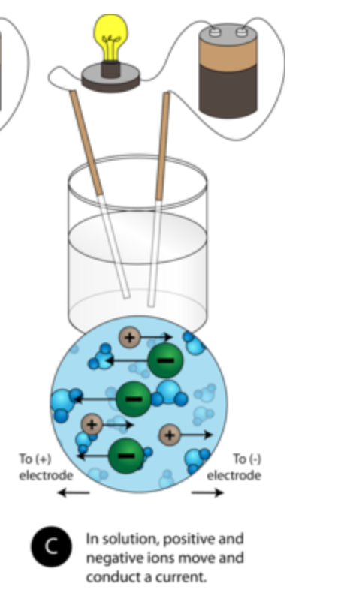
Ionic Compounds
Most ionic solids are soluble in water
Good electrolytes when dissolved in water (support an electric current)
The ions are free to move (mobile)

Slide 7
Ionic Compounds
Ionic solids are not conductors
If you melt an ionic compound, it will conduct electricity
Mobile ions

Slide 8
Ionic Compounds
Brittle solids
They break into smaller pieces

Slide 9
Covalent Bonds
Involves sharing of electrons between atoms
Made from 2 non-metal atoms

Slide 10
Molecular Covalent Substances
Made from non-metal elements
Individual molecules

Slide 11
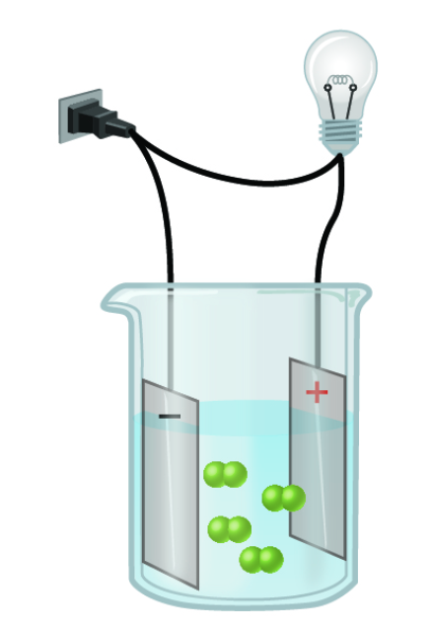
Molecular Covalent Substances
Can be found as solids, liquids or gases
Low melting points and boiling points
May or may not dissolve in water
Soluble molecular covalent substances are typically poor electrolytes or non-electrolytes

Slide 12
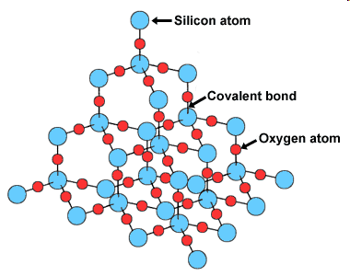
Network Covalent Compounds
All of the atoms share electrons in covalent bonds with all of the atoms around them
Diamond
Silicon dioxide
Very hard
High boiling points

Slide 13
Metallic Bonding
Involve only metal atoms
Metals do not dissolve in water
Metals have high melting and boiling points

Slide 14
Metallic Bonding
Involve only metal atoms
The solids are good conductors of electricity

Slide 15
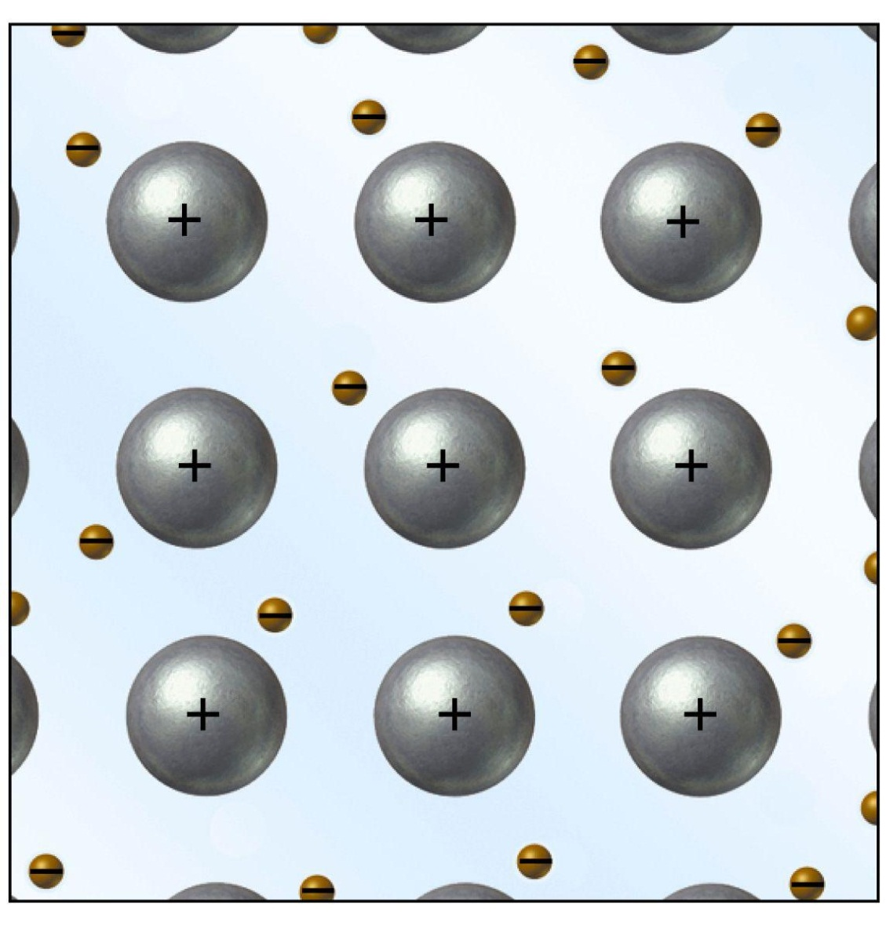
Metallic Bonding
Many metal atoms share their valence electrons in common
“electron sea model”
The valence electrons are “delocalized”

Slide 16
Metallic Bonding
Metals are malleable
The nuclei will rearrange if an external force is applied

