Slide 1
Classification of Matter
Bromfield Honors Chemistry

Slide 2
Chemistry
The study of the composition of substances and the changes they undergo

Slide 3
Chemistry
The study of the composition of substances and the changes they undergo
Many different “branches” of chemistry
Notes:
Generate list of the branches of chemistry: esp. ORGANIC, inorganic, physical, analytical, biochemistry, nuclear, etc.

Slide 4
Chemistry
The study of the composition of substances and the changes they undergo
Many different “branches” of chemistry
All matter has a chemical basis
Matter = anything that has mass and volume

Slide 5
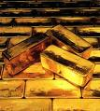
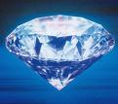
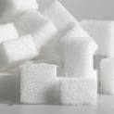
Substance
A particular kind of matter with a uniform and constant composition
Au
C₁₂H₂₂O₁₁
Can be represented by a single chemical formula
“pure”
A₂

Slide 6
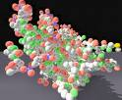


Molecules
Clusters of atoms behaving as a unit because they are chemically joined

Slide 7
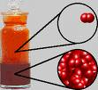
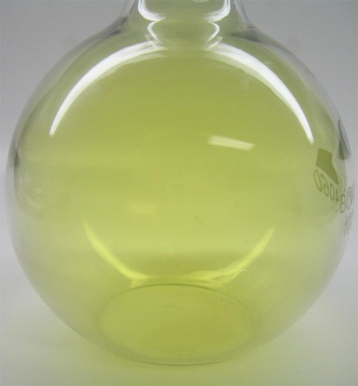

Two classes of pure substances
Element
pure substance containing only 1 type of atom
Can’t be broken down into simpler substances
About 100 different elements
~90 elements occur naturally

Slide 8
Two classes of pure substances
Compound
pure substance containing only 1 type of molecule
The molecules must contain 2 or more different kinds of atoms
Can be broken down into simpler substances

Slide 9
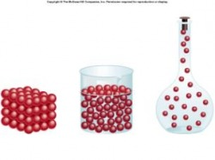
A sample of elemental matter can be broken down into simpler substances.
A. True
B. False

Slide 10
A sample of elemental matter can be broken down into simpler substances.
A. True
B. False

Slide 11
A molecule must contain two different kinds of atoms.
A. True
B. False

Slide 12
A molecule must contain two different kinds of atoms.
A. True
B. False

Slide 13
A compound must contain (at least) 2 different kinds of atoms.
A. True
B. False

Slide 14
A compound must contain (at least) 2 different kinds of atoms.
A. True
B. False

Slide 15
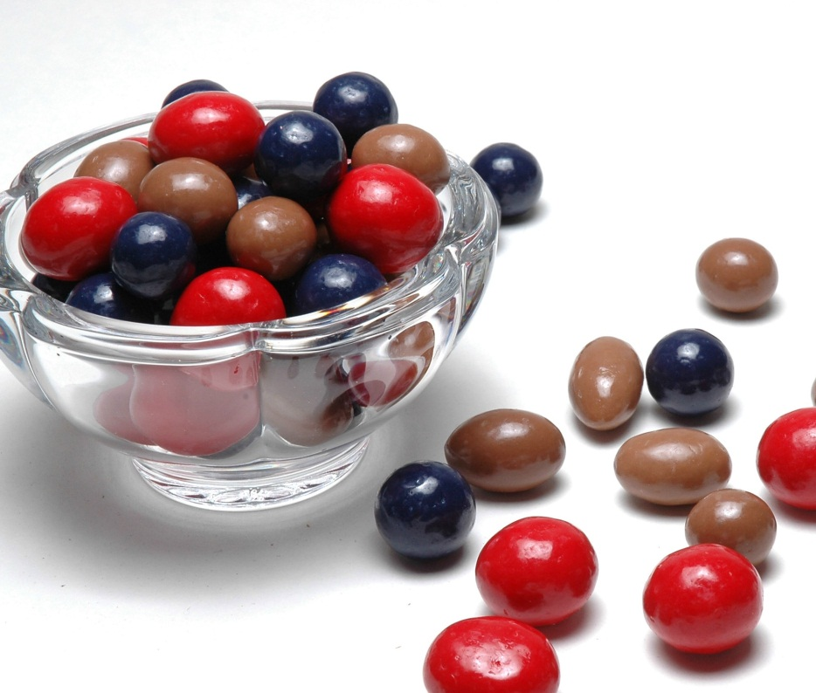
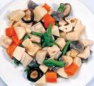
Mixture
A sample of matter containing 2 or more different pure substances, physically blended together

Slide 16

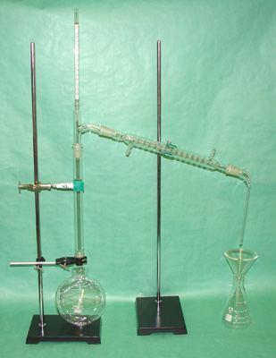
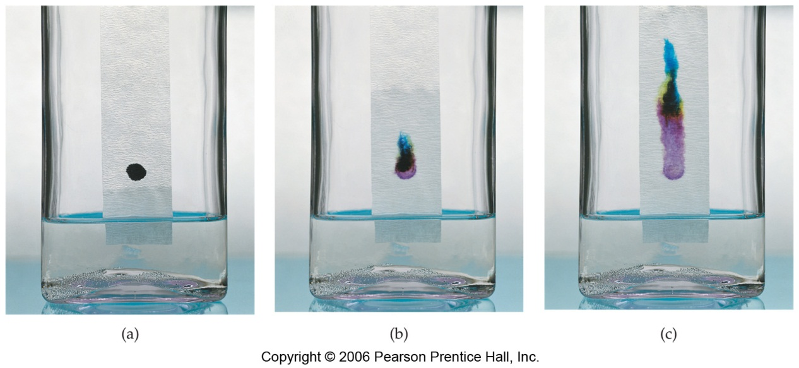
Mixture
The components can be separated by physical means
Notes:
Briefly mention some different separation techniques

Slide 17

2 categories of mixtures
Homogeneous
Components are uniformly distributed
Aka solution
May be in solid, liquid, or gas phase
Alloy—homogeneous mixture of metals

Slide 18
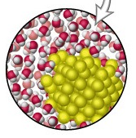

2 categories of mixtures
Heterogeneous
Components are non-uniformly distributed

Slide 19
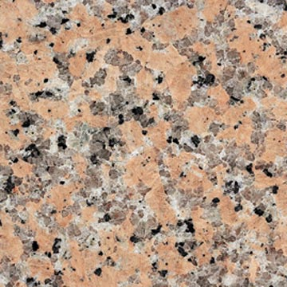
2 categories of mixtures
Heterogeneous
Components are non-uniformly distributed
Ratios of components may vary throughout
May observe distinct phases or an interface

Slide 20
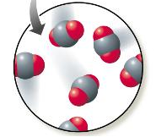
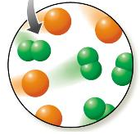
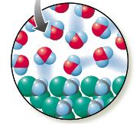
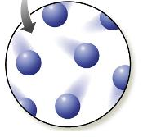
What types of matter are shown?
A
B
C
D

Slide 21
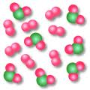
The picture shows a mixture of two compounds.
A. True
B. False

Slide 22
The picture shows a mixture of two compounds.
A. True
B. False

Slide 23
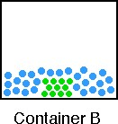
The picture illustrates a heterogeneous mixture in the solid phase.
A. True
B. False

Slide 24
The picture illustrates a heterogeneous mixture in the solid phase.
A. True
B. False

