Slide 1
Converting between mass, moles and particles
Dr V’s Chemistry webcasts

Slide 2
Objectives
Calculate particles of a substance from moles
Calculate moles of a substance from particles
Introduce two step problems: Mass to moles to particles

Slide 3
A mole
A sample containing 6.022 x 10²³ particles
Avogadro’s number
Each of these beakers
contains one mole of that substance
https://sites.google.com/site/sch3uyork/3-quantities-in-chemical-reactions/misconceptions

Slide 4
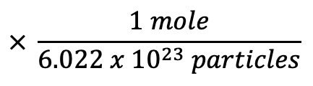
The mole road
To calculate moles from particles (atoms or molecules):
$$× \frac{1 mole}{6.022 x {10}^{23} particles}$$
particles
moles

Slide 5
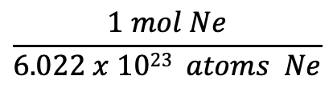

Practice Problem #1
How many moles are present in a sample containing 8.54 x 10²³ atoms of neon?
$$x mol=\text{8.54 }\text{x}\text{ 1023 }\text{atoms} \text{Ne}$$
$$\frac{1 mol Ne}{6.022 x 1023 atoms Ne}$$
= 1.42 moles Ne
Sig figs and units!

Slide 6
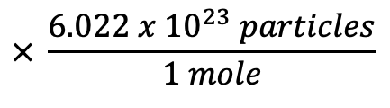
The mole road
To calculate moles from particles:
$$× \frac{1 mole}{6.022 x {10}^{23} particles}$$
particles
moles
$$× \frac{6.022 x {10}^{23} particles}{1 mole}$$
To calculate number of particles from moles

Slide 7
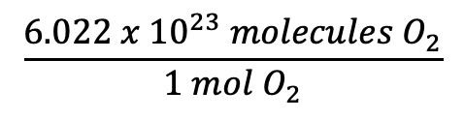

Practice Problem #2
How many molecules are present in a 0.39 mole sample of oxygen gas?
$$x molecules=0.39 mol O_{2}$$
$$\frac{6.022 x {10}^{23} molecules O_{2}}{1 mol O_{2}}$$
= 2.4 x 10²³ oxygen molecules

Slide 8
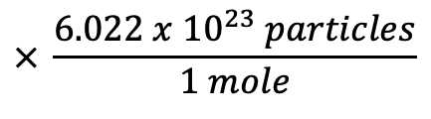
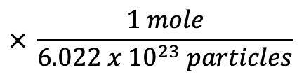
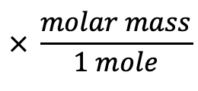
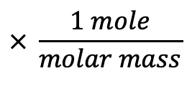
Mole Road, multistep problems
$$× \frac{1 mole}{molar mass}$$
$$× \frac{6.022 x {10}^{23} particles}{1 mole}$$
grams
moles
particles
$$× \frac{molar mass}{1 mole}$$
$$× \frac{1 mole}{6.022 x {10}^{23} particles}$$

Slide 9
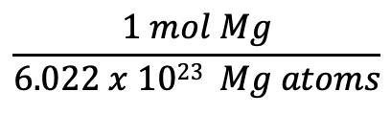

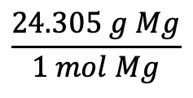
Practice Problem #3
What is the mass in grams of a sample of magnesium containing 5.60 x 10²³ atoms?
$$x g Mg=5.60 x {10}^{23}Mg atoms$$
$$\frac{1 mol Mg}{6.022 x 1023 Mg atoms}$$
$$\frac{24.305 g Mg}{1 mol Mg}$$
= 22.6 g Mg
Sig figs and units!

Slide 10
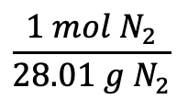

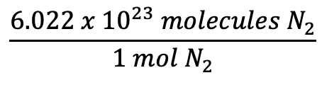
Practice Problem #4
How many nitrogen molecules are present in a 59 g sample of nitrogen?
$$x N_{2} molecules=59 g N_{2}$$
$$\frac{1 mol N_{2}}{28.01 g N_{2}}$$
$$\frac{6.022 x {10}^{23} molecules N_{2}}{1 mol{ N}_{2}}$$
= 1.3 x 10²⁴ molecules
Sig figs and units!

Slide 11
Found this helpful?
Like the video!
Leave a comment!
Subscribe to my channel!

