Slide 1
Chemical Bonding
Bromfield Honors Chemistry

Slide 2
Chemical Bonding
Stability
Lewis dot structures
Electron configurations
Valence electrons
Ionic bonds
Metallic bonds
Covalent bonds
Ionic compounds
Polar bonds
Molecular orbitals
Hybrid orbitals
properties
Nonpolar bonds
properties
Covalent compounds
Molecular covalent
Intermolecular attractions
Network covalent
Resonance structures
VSEPR theory

Slide 3
Why do bonds form?
To achieve a more stable state
Using Nanoscience to Understand
The Properties of Matter

Slide 4
Why do bonds form?
To achieve a more stable state
i.e., to get to a state of lower energy

Slide 5
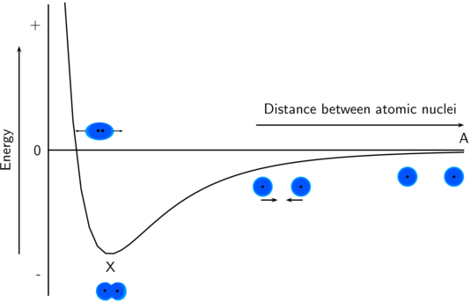
Why do bonds form?
To achieve a more stable state interactive
Energy is released when bonds are formed

Slide 7
Why do bonds form?
To achieve a more stable state
Bond formation is an EXOTHERMIC process

Slide 8
Bond energy
The energy required to break a bond
Breaking a bond is endothermic!

Slide 9
Bond energy
The energy required to break a bond
Breaking a bond is endothermic!
Bond energy is a measure of bond strength

Slide 10
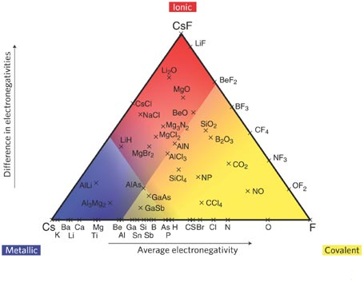
Classes of chemical bonds
How do valence electrons interact to form a bond?
Ionic bonds
Covalent bonds
Network covalent
Molecular covalent
Metallic bonds

Slide 11
Ionic Compounds
Features

Slide 12
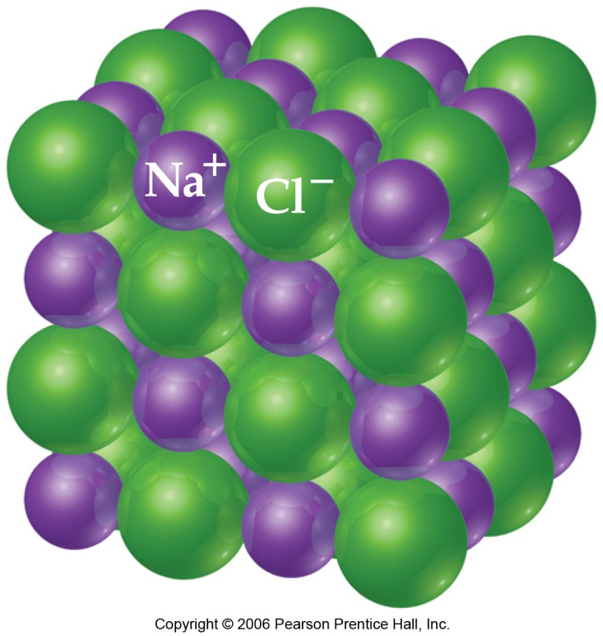
Ionic Compounds
Features

Slide 13
Molecular Covalent Compounds
Features

Slide 14
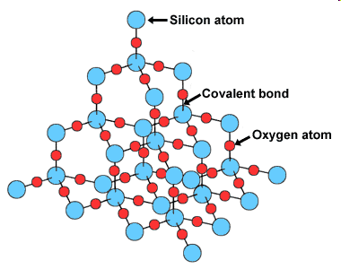
Network Covalent Compounds
Aging Diamonds

Slide 15
Metallic Bonding

Slide 16
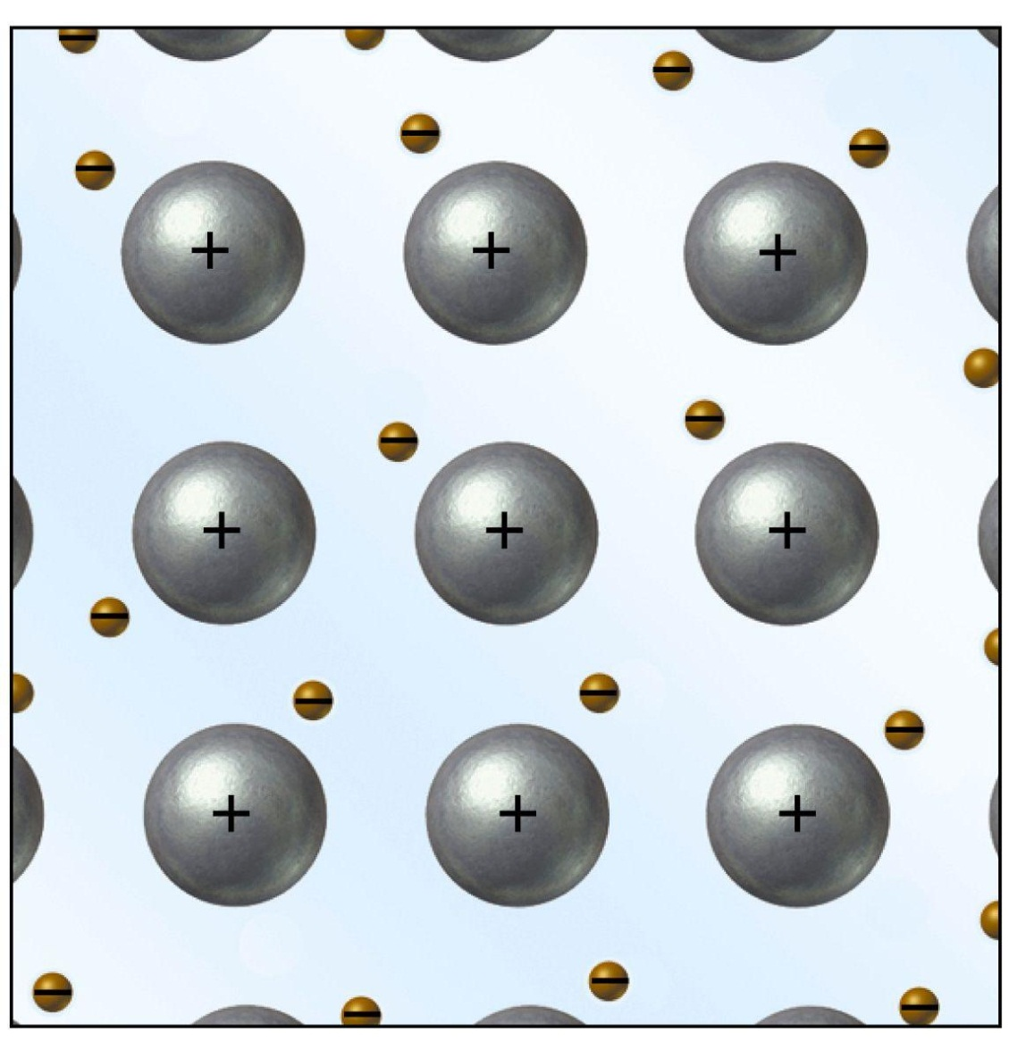
Metallic Bonding
Animation

Slide 17
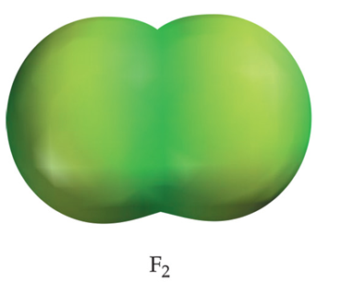
2 subcategories of covalent bonding
Nonpolar covalent
Equal sharing of electrons between atoms
Polar covalent
Unequal sharing of electrons between atoms
δ+
δ-

Slide 18
Electronegativity
Notes:
Figure: 08-06
Title:
Electronegativities of the elements.
Caption:
Electronegativity generally increases from left to right across a period and decreases from top to bottom down a group.

Slide 19
Predicting Bond Type
Metal + nonmetal
2 nonmetals
Look at differences in electronegativity
ΔEN ≤ 0.3
ΔEN >0.3

Slide 21
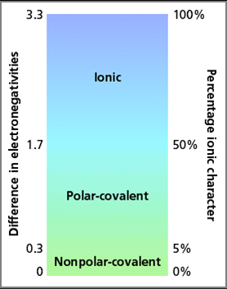

Slide 23
Predicting Bond Types
S, O
C, O
Mg, N
P, F
Ni, Cl
Se, Br
N, Cl
C, Cl

Slide 24
Bond Types

