Slide 1
The Light Equations: Calculations
Bromfield Honors Chemistry

Slide 2
Objectives
Video
Review the light equations
Solve sample problems

Slide 3
The key equations
c = λν

Slide 4
The key equations
c = λν
E = hν
Memorize these!

Slide 5

The key equations
c = λν
  Rearrange: ν = $\frac{c}{λ}$
E = hν
Put together:

Slide 6
The constants
Speed of light in a vacuum
c = 3.00 x 10⁸ m/s

Slide 7
The constants
Speed of light in a vacuum
c = 3.00 x 10⁸ m/s
Planck’s constant
h = 6.626 x 10⁻³⁴ J s

Slide 8
Problem 1
A red laser beam has a wavelength of 690 nm
  Calculate the frequency, in s⁻¹, of the light.

Slide 9
Problem 1
c = λν
A red laser beam has a wavelength of 690 nm
  Calculate the frequency, in s⁻¹, of the light.

Slide 10

Problem 1
c = λν,
$$ν= \frac{c}{λ}$$
A red laser beam has a wavelength of 690 nm
  Calculate the frequency, in s⁻¹, of the light.

Slide 11

Problem 1
c = λν,
$$ν= \frac{c}{λ}$$
$690 nm ∗ \frac{1x {10}^{−9} m}{1 nm}$ = 6.9 x 10⁻⁷ m
A red laser beam has a wavelength of 690 nm
  Calculate the frequency, in s⁻¹, of the light.

Slide 12
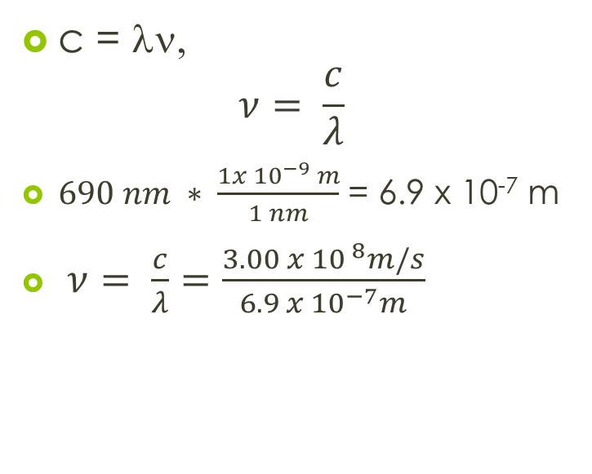
Problem 1
c = λν,
$$ν= \frac{c}{λ}$$
$690 nm ∗ \frac{1x {10}^{−9} m}{1 nm}$ = 6.9 x 10⁻⁷ m
$ν= \frac{c}{λ}=\frac{3.00 x {10}^{ 8}m/s}{6.9 x {10}^{−7}m}$
A red laser beam has a wavelength of 690 nm
  Calculate the frequency, in s⁻¹, of the light.

Slide 13
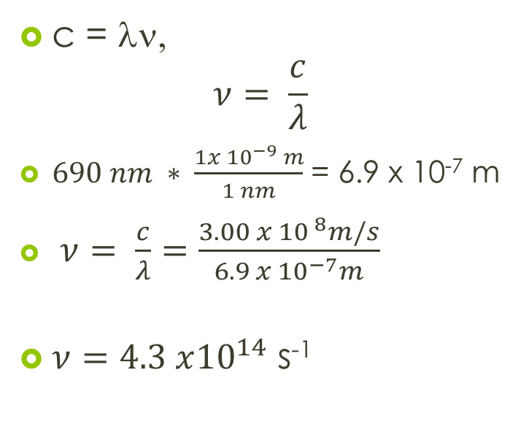
Problem 1
c = λν,
$$ν= \frac{c}{λ}$$
$690 nm ∗ \frac{1x {10}^{−9} m}{1 nm}$ = 6.9 x 10⁻⁷ m
$ν= \frac{c}{λ}=\frac{3.00 x {10}^{ 8}m/s}{6.9 x {10}^{−7}m}$
$ν=4.3 x{10}^{14}$ s⁻¹
A red laser beam has a wavelength of 690 nm
  Calculate the frequency, in s⁻¹, of the light.

Slide 14
Problem 2
A red laser beam has a wavelength of 690 nm
  Calculate the energy, in joules of one photon of this light.

Slide 15
Problem 2
E = hν, c = λν
A red laser beam has a wavelength of 690 nm
  Calculate the energy, in joules of one photon of this light.

Slide 16

Problem 2
E = hν, c = λν
$E= \frac{hc}{λ}$
A red laser beam has a wavelength of 690 nm
  Calculate the energy, in joules of one photon of this light.

Slide 17
Problem 2
E = hν, c = λν
$E= \frac{hc}{λ}$
A red laser beam has a wavelength of 690 nm
  Calculate the energy, in joules of one photon of this light.

Slide 18
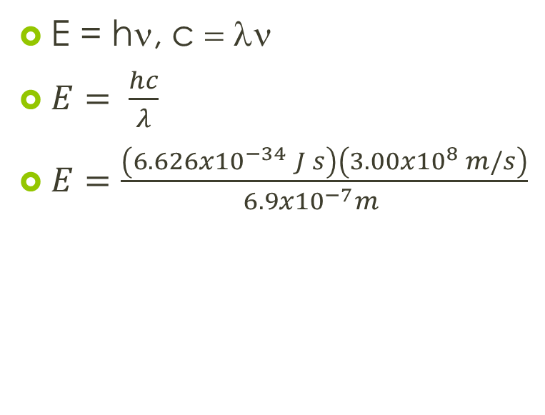
Problem 2
E = hν, c = λν
$E= \frac{hc}{λ}$
$E=\frac{\left(6.626x{10}^{−34} J s\right)\left(3.00x{10}^{8} m/s\right)}{6.9x{10}^{−7}{m }^{}}$
A red laser beam has a wavelength of 690 nm
  Calculate the energy, in joules of one photon of this light.

Slide 19
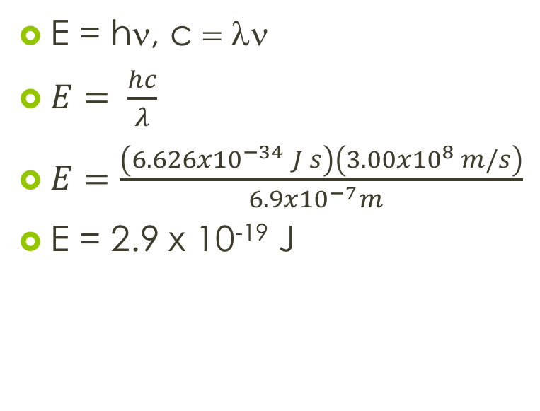
Problem 2
E = hν, c = λν
$E= \frac{hc}{λ}$
$E=\frac{\left(6.626x{10}^{−34} J s\right)\left(3.00x{10}^{8} m/s\right)}{6.9x{10}^{−7}{m }^{ }}$
E = 2.9 x 10⁻¹⁹ J
A red laser beam has a wavelength of 690 nm
  Calculate the energy, in joules of one photon of this light.

