Slide 1
The Modern Model of the Atom
Bromfield Honors Chemistry

Slide 2
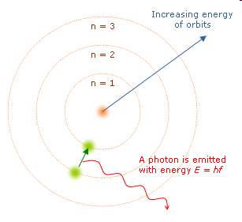
The Bohr Model…recap
Electrons travel around the nucleus in fixed circular orbits
Only certain orbits, at certain distances, are allowed
Video: Atoms—The Space Between

Slide 3
The Bohr Model…recap
Only certain orbits, with certain energies, are allowed
Energy is quantized!

Slide 4
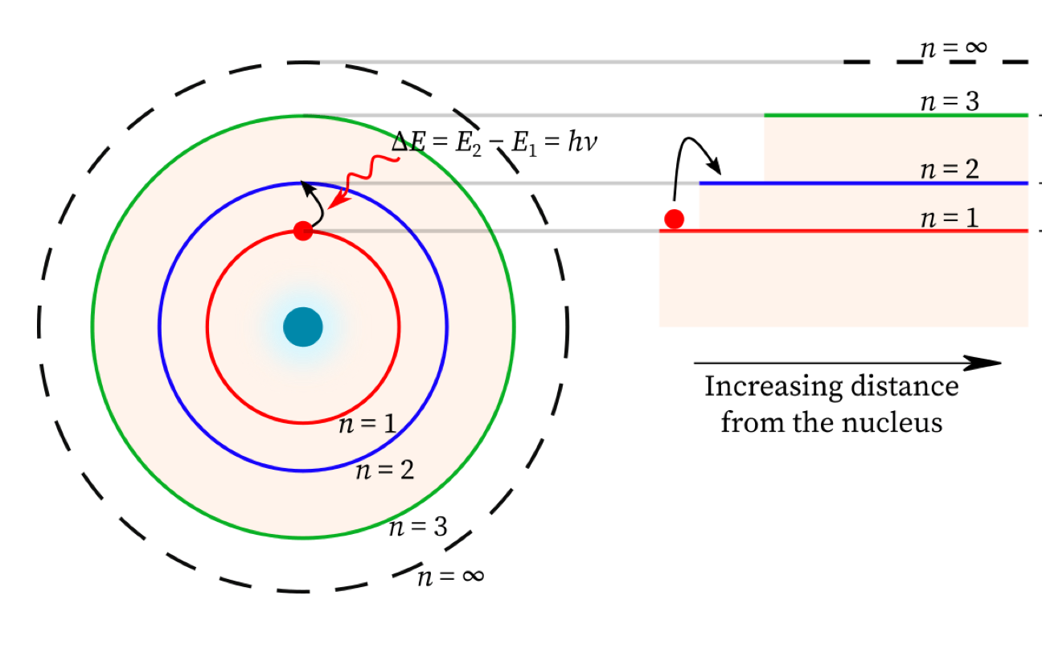
Electrons can transition between energy level

Slide 5
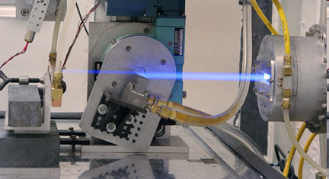
Problems with the Bohr model
Only works for one electron atoms
Electrons travelling in circular orbits give off electromagnetic radiation
  Why don’t they just collapse into the nucleus?
Brookhaven Synchrotron Source

Slide 6
The Modern Model
A mathematical, statistical description of electrons in atoms
Video: Quantum Mechanics

Slide 7
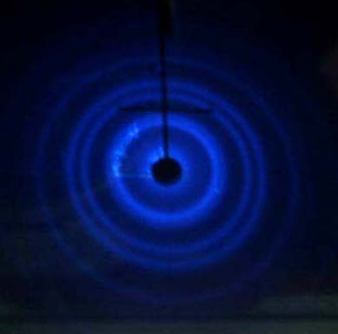

Louis de Broglie
Electrons have wave-like properties
  Can be diffracted
  Wave-particle duality
  Anything with both mass and velocity has a corresponding wavelength!
$$λ= \frac{h}{mv}$$
Notes:
Anything with both mass and velocity has a corresponding wavelength, the deBroglie wavelength: lambda = h/mv

Slide 8
Standing waves
We can find waves that have just the right wavelength
for a circle with a particular radius

Slide 9
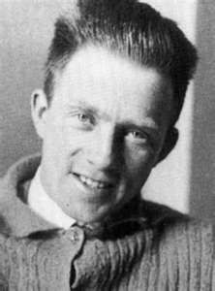
Werner Heisenberg
Uncertainty Principle
We can’t know the location and momentum of an electron simultaneously.

Slide 10
Werner Heisenberg
Uncertainty Principle
VIDEO
1932 Nobel Prize in Physics “for the creation of quantum mechanics”

Slide 11
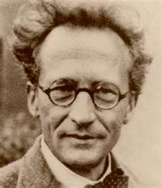
Erwin Schrödinger
We can use waves to predict the locations of electrons.
  “wave functions”
  To solve the equations, energy must be quantized
  1933 Nobel Prize in Physics

Slide 12
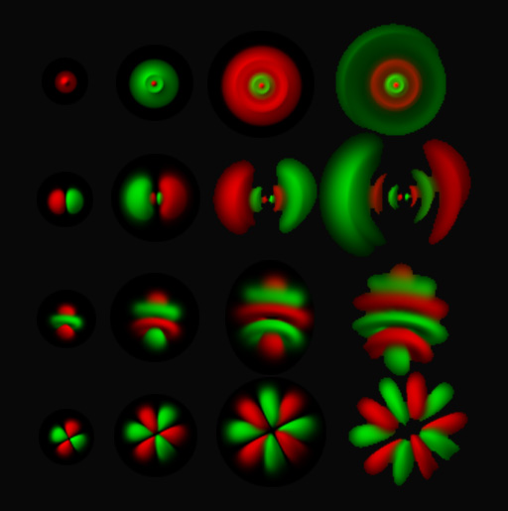
Modern Model
Orbital: region of space where electron is likely to be found

Slide 13
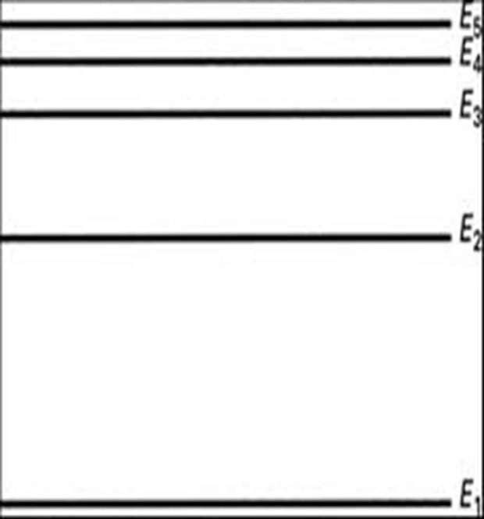
Modern Model
Orbital: region of space where electron is likely to be found
Orbitals are arranged in primary energy levels (just like those in the Bohr model)

Slide 14
Sublevels
”Sublevels” consist of different orbital shapes
4 different types of common orbitals
  s
  p
  d
  f

Slide 15
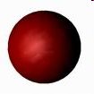
s orbitals
“s” orbitals
Spherical shape
1 s orbital in an s sublevel

Slide 16
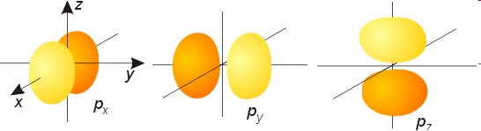
p orbitals
Dumbbell shape
3 orbitals in a p sublevel
  Oriented at 90º angles to each other

Slide 17
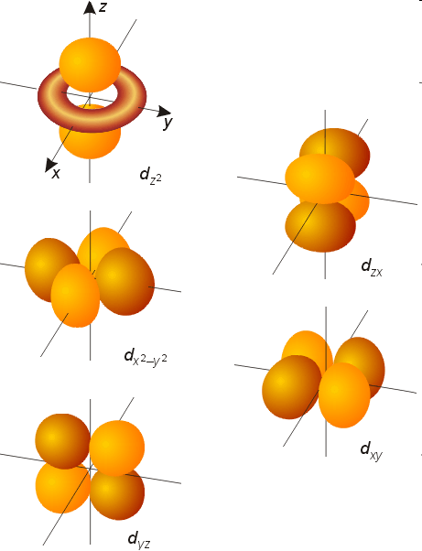
d orbitals
Dumbbell shape
5 d orbitals in a d sublevel

Slide 18
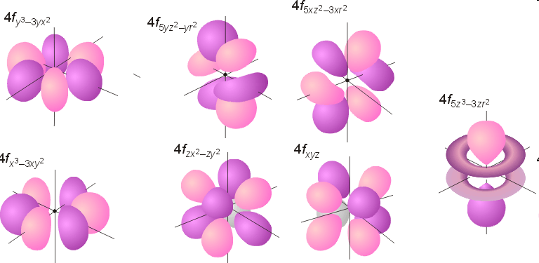
f orbitals
7 f orbitals in an f sublevel

Slide 20
Summary
The modern model of the atom is a mathematical model of electrons in atoms
  Orbitals are regions of space where electrons are likely to be found.
  Orbitals are arranged in energy levels and sublevels.
    There are different types of orbitals.

Slide 21
Principal Energy Level
n

Slide 22
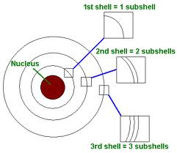
Principal Energy Level
Value of n gives the maximum number of sublevels in level

Slide 23
Principal Energy Level
n² gives the maximum number of orbitals in energy level n

Slide 24
Principal Energy Level
2n² gives the maximum number of electrons in energy level n

Slide 25
Problems
What is the maximum number of orbitals permitted in energy level 3?
What is the maximum number of electrons permitted in energy level 4?
What is the maximum number of sublevels (types of orbitals) in energy level 5?

