Slide 1
Writing Electron Configurations
Bromfield Honors Chemistry

Slide 2
Objectives
3 rules for writing electron configurations
3 different formats for writing electron configurations
Practice problems

Slide 3
Analogy

Slide 4
Aufbau principle
Orbitals are filled in order of INCREASING energy

Slide 5
Aufbau principle
Start with energy level 1
Then energy level 2, and so on
In general, s < p < d < f in the same energy level

Slide 6
Writing an e- config for H
H has 1 electron
Orbital notation: Arrows and boxes
Spectroscopic notation

Slide 7
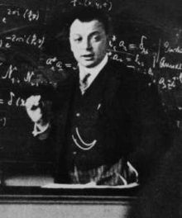
Pauli Exclusion Principle
Version 1:
No two electrons in the same atom can have identical sets of the 4 quantum numbers.

Slide 8
Electrons have a property called “spin”

Slide 9
Pauli Exclusion Principle
Version 2:
Two electrons may occupy the same orbital, but they must have opposite spins.

Slide 10
Use both arrows& box notation and spectroscopic notation to write electron configurations for...
Helium
Lithium
Beryllium
Boron

Slide 11
Hund’s Rule
Applies to p, d and f sub levels
“degenerate orbitals”—all the orbitals in the sublevel have the same energy
Friedrich Hund, in the 1920’s

Slide 12
Hund’s Rule
For degenerate orbitals (i.e., p, d and f sublevels), place one electron in each orbital, all spin aligned, before pairing any electrons
3p sublevel

Slide 13
Write electron configurations…
Carbon
Nitrogen
Neon
Sulfur

Slide 14
Do now…
What is the mistake in each of the following electron configurations?
a) $\frac{↿⇂}{1s}\frac{↿}{2s}\frac{↿}{2p}\frac{↿}{2p}\frac{}{2p}$
c) $\frac{↿⇂}{1s}\frac{↿⇂}{2s}\frac{↿⇂}{2p}\frac{↿}{2p}\frac{ }{2p}$
b) $\frac{↿⇂}{1s}\frac{↿⇂}{2s}\frac{↿⇂}{2p}\frac{↿⇂}{2p}\frac{↿⇂}{2p}$ $\frac{⇂⇂}{3s}$
d) $\frac{↿⇂}{1s}\frac{↿⇂}{2s}\frac{↿⇂}{2p}$ $\frac{↿}{3s}$

Slide 15
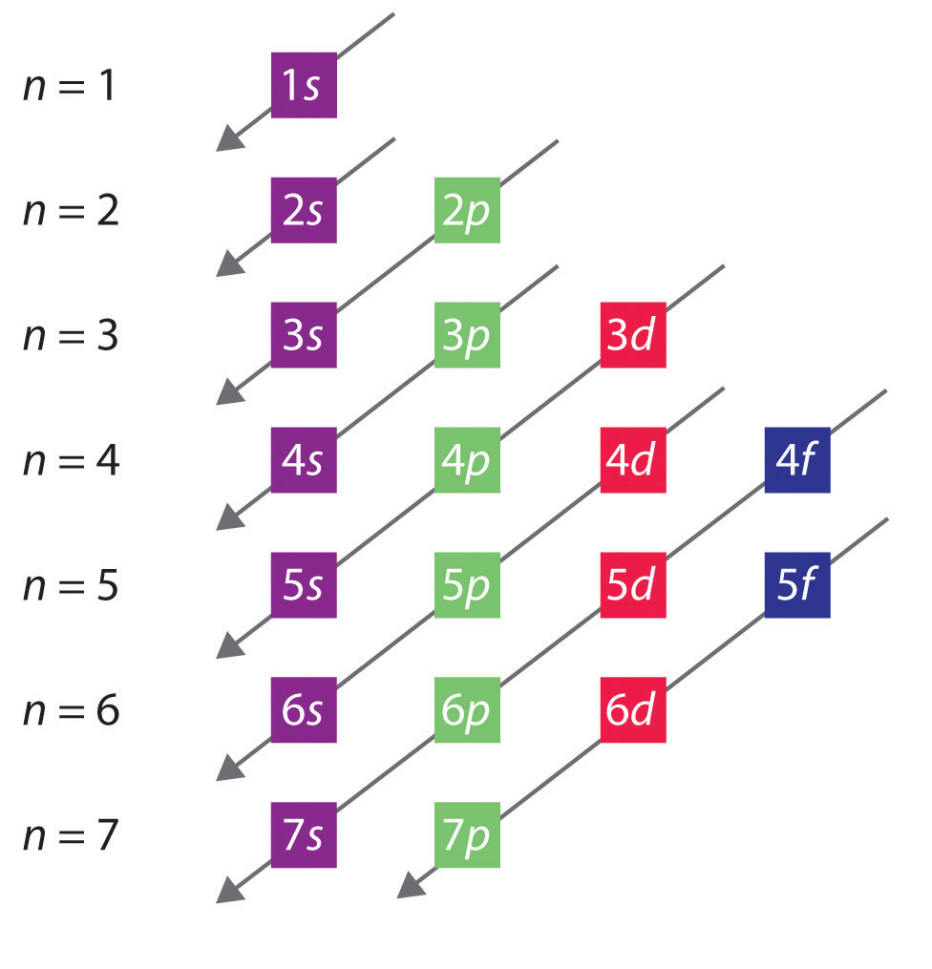
Aufbau principle
Mnemonic
After 3p, the filling sequence goes “out of order”

Slide 16
Write the expected ground state electron configuration for…
Chromium

Slide 17
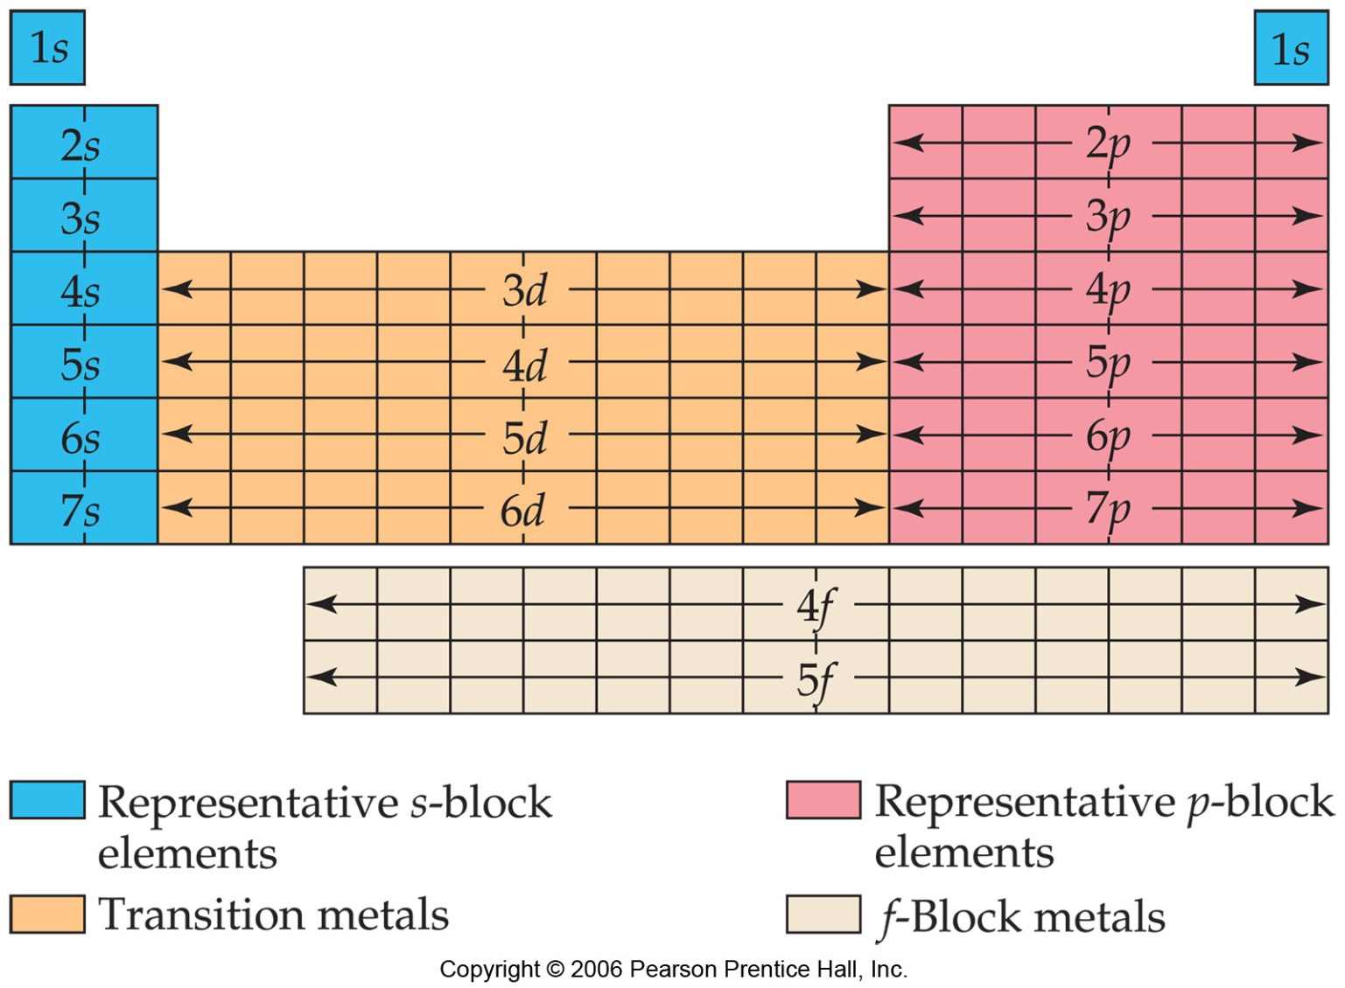
Use the periodic table…

Slide 18
3rd way…noble gas notation
Use group 18 element to represent the inner (“core”) electrons
Ex. Carbon
[He]2s² 2p²

Slide 19
Valence electrons
Ex. Carbon
[He]2s² 2p²
Outermost s and p electrons (d electrons don’t count as valence electrons)
4 valence electrons

Slide 20
Use noble gas notation to write electron configurations for…
Magnesium
Iron
Iodine
Bismuth

Slide 21
Lewis dot diagrams
1 dot for each valence electron
Ex. Carbon
[He]2s² 2p²
C

Slide 22
Lewis dot diagrams
For main block elements,
# valence electrons = group number
Draw Lewis dot diagrams for..
Mg S
N Al

