Slide 1
Buffers
Bromfield AP Chemistry

Slide 2
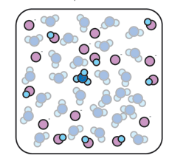


Preparing buffers
Mix a weak acid with a salt of its conjugate base
Ex. Nitrous acid (HA) and sodium nitrite (a source of A⁻)
Sodium ions not shown!

Slide 3
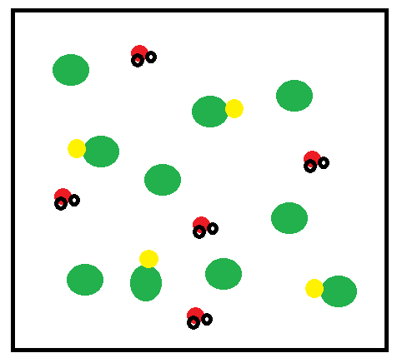
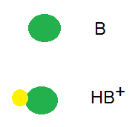
Preparing buffers
OR mix a weak base with a salt of its conjugate acid
Ex. Ammonia (B) and ammonium chloride (HB⁺)
Chloride ions not shown

Slide 4
Buffers
Because both a weak acid and a weak base are present, buffer solutions resist pH changes when acid or base is added.
Animation #1

Slide 5
K_{a} expressions

Slide 6
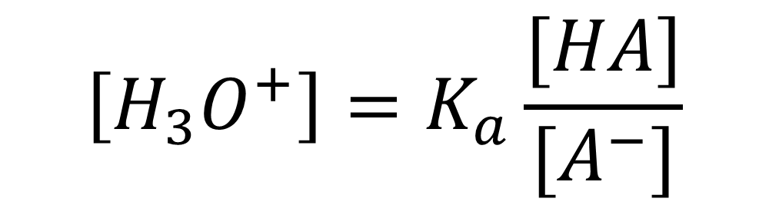
Rearrange: K_{a} expressions
$$\left[H_{3}O^{+}\right]=K_{a}\frac{[HA]}{[A^{−}]}$$
Similarly, for a basic buffer we can rearrange the K_{b} expression to find [OH⁻]

Slide 7
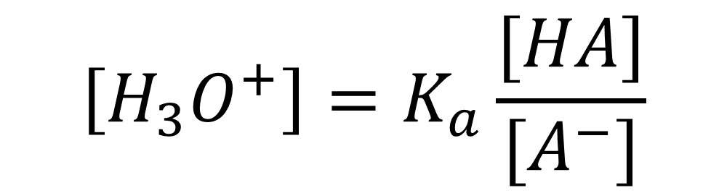
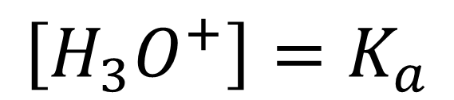
What happens when [HA] = [A⁻]?
$$\left[H_{3}O^{+}\right]=K_{a}\frac{[HA]}{[A^{−}]}$$
$$\left[H_{3}O^{+}\right]=K_{a}$$

Slide 8
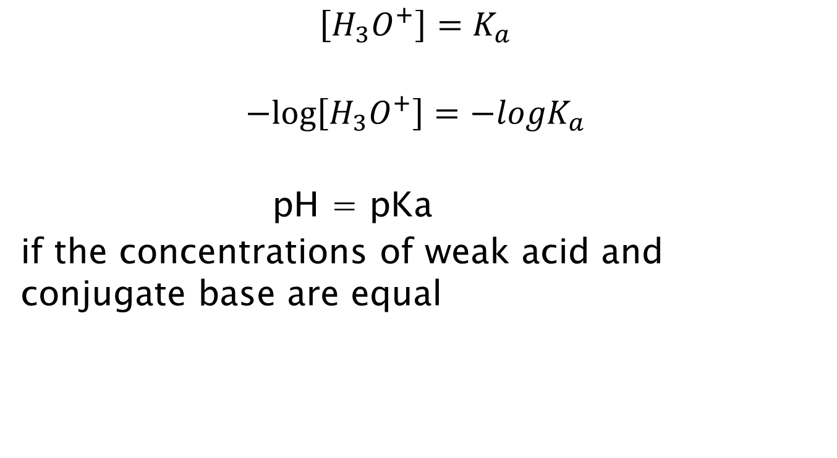
Take the negative log of both sides…
$$\left[H_{3}O^{+}\right]=K_{a}$$
$$−log\left[H_{3}O^{+}\right]={−logK}_{a}$$
pH = pKa
if the concentrations of weak acid and conjugate base are equal

Slide 9
Calculating the pH of a buffer solution
What is the pH of a buffer composed of 0.25 M benzoic acid and 0.15M sodium benzoate? The K_{a} of benzoic acid is 6.3 x 10⁻⁵

Slide 10
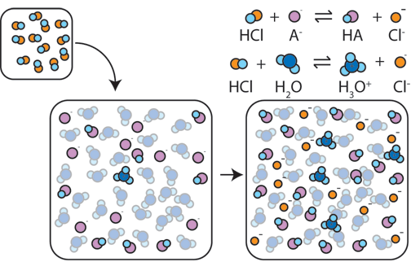
Adding strong acid to a buffer

Slide 11
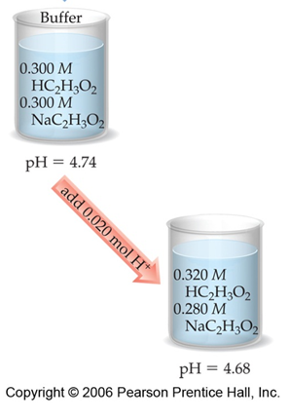
Adding strong acid
Buffer: acetic acid and sodium acetate
Add HCl (source of H⁺): will react with acetate ion

Slide 12
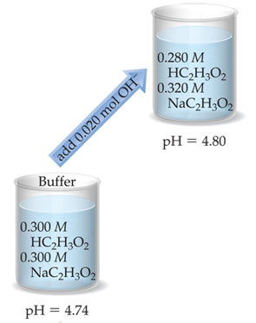
Adding strong base
Buffer: acetic acid and sodium acetate
Add NaOH (source of OH⁻): will react with acetic acid

Slide 13
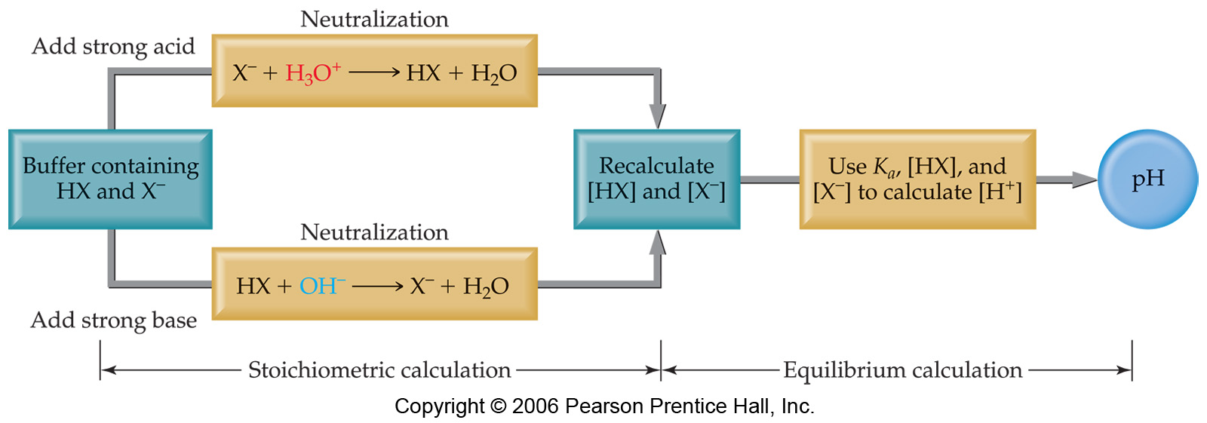
Calculating pH changes in buffers

Slide 14
Calculating pH changes in buffers
A buffer is made by adding 0.300 mol HC₂H₃O₂ and 0.300 mol NaC₂H₃O₂ to enough water to make 1.00 L of solution. The pH of the buffer is 4.74.Calculate the pH of this solution after 0.050 mol of NaOH is added.

Slide 15
Buffer range
Buffers work best in a pH range ±1 from the pK_{a} value of the weak acid
pKa = -log(K_{a})
If Ka is large, pKa is small…
Stronger acids have smaller pKa values

Slide 16
Buffer capacity
It is possible to add more strong acid (or base) than the buffer system can react with!

