Slide 1
Discussing Acid Strength
% ionization
Ka values

Slide 2
Strong vs. weak
It’s all about the extent of ionization.

Slide 3
Strong acids
  Strong acids and bases ionize completely (100% ionization) when dissolved in water
    All H⁺ and A⁻ ions in solution
  Strong acids/bases are good electrolytes

Slide 4
Weak acids
  Weak acids and bases only partially ionize (typically, <5% ionization)when dissolved in water
    Mostly HA molecules in solution
  Weak acids & bases are poor electrolytes

Slide 5
Strong vs. weak
Don’t confuse acid/base strength (% ionization) with concentration (moles/L)

Slide 6
Acid/Base Ionization Constants
One way to categorize acid/base strength is to use ionization constants.
  i.e, equilibrium constants (K_{a} or K_{b})

Slide 7
Acid/Base Ionization Constants
Large K_{a}/K_{b} constant
  High degree of dissociation
  Strong acid (or base)
  For very strong acids/bases, the K value approaches infinity

Slide 8
Acid/Base Ionization Constants
Small K_{a} or K_{b} constant
  Low degree of dissociation
  Weak acid (or base)

Slide 9
Acid Dissociations
Ex. Nitrous acid
HNO_{2(aq)} + H₂O_{(l)} ⇌ NO₂⁻_{(aq)} + H₃O⁺_{(aq)}

Slide 10
Acid Dissociations
Ex. Nitrous acid
HNO_{2(aq)} + H₂O_{(l)} ⇌ NO₂⁻_{(aq)} + H₃O⁺_{(aq)}

Slide 11
Acid Dissociations
Ex. Nitrous acid
HNO_{2(aq)} + H₂O_{(l)} ⇌ NO₂⁻_{(aq)} + H₃O⁺_{(aq)}
K_{a} = 4.6 x 10⁻⁴

Slide 12
Acid Dissociations
Ex. Nitrous acid
HNO_{2(aq)} + H₂O_{(l)} ⇌ NO₂⁻_{(aq)} + H₃O⁺_{(aq)}
K_{a} = 4.6 x 10⁻⁴
Small K_{a} value, ∴nitrous acid is a weak acid

Slide 13
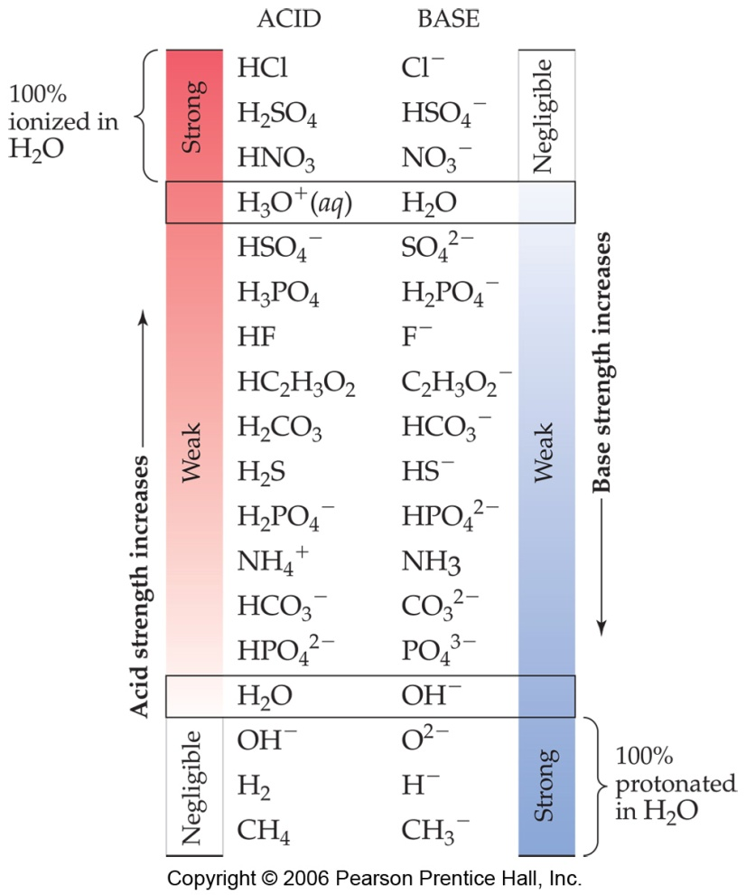
Conjugate Pairs, revisited
The stronger the acid, the weaker its conjugate base

Slide 14
Conjugate Pairs, revisited
The stronger the base, the weaker its conjugate acid

Slide 15
Base Dissociations
Ex. NH₃
NH₃(aq) + H₂O(l) ⇌ NH₄⁺(aq) +OH⁻(aq)

Slide 16
Base Dissociations
Ex. NH₃
NH₃(aq) + H₂O(l) ⇌ NH₄⁺(aq) +OH⁻(aq)

Slide 17
Base Dissociations
Ex. NH₃
NH₃(aq) + H₂O(l) ⇌ NH₄⁺(aq) +OH⁻(aq)
K_{b} = 1.77 x 10⁻⁵

Slide 18
Base Dissociations
Ex. NH₃
NH₃(aq) + H₂O(l) ⇌ NH₄⁺(aq) +OH⁻(aq)
K_{b} = 1.77 x 10⁻⁵
Small K_{b} value, ∴ ammonia is a weak base

