Slide 1
Periodic trends: multiple ionization energies
DR V’S AP CHEMISTRY WEBCASTS

Slide 2
objectives
Introduce multiple (successive) ionization energies
Trends in successive ionization energies
Practice problems

Slide 3
Multiple Ionization Energies
First Ionization Energy
  The energy required to remove the outermost electron
Second Ionization Energy
  The energy required to remove a second electron
A + IE₁
➝ A⁺ + e⁻
A⁺ + IE₂ ➝ A²⁺ + e⁻

Slide 4
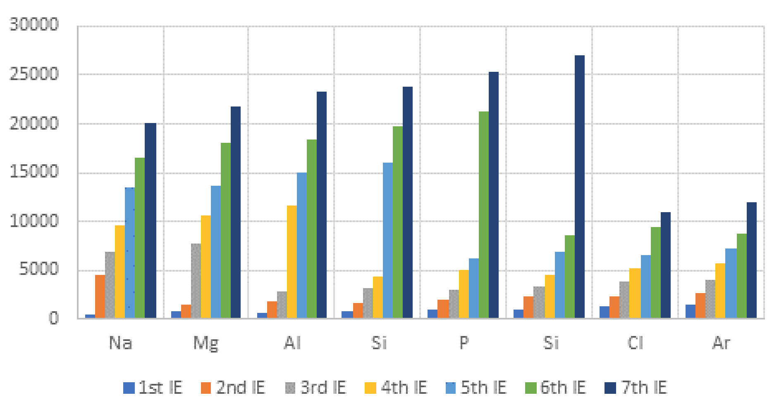
Multiple ionization energies
You can have as many ionization energies as there are electrons in the atom
Ionization Energies for Elements in Period 2
Element | IE₁ (kJ/mol) | IE₂ (kJ/mol) | IE₃ (kJ/mol)
Na | 498 | 4560 | 6912
Mg | 736 | 1445 | 7733
Al | 577 | 1815 | 11575
Graph
created
by
Mr. Melican

Slide 5
Multiple ionization energies
Each successive ionization energy is larger than the previous ionization energy
    Fewer electron:electron repulsions
Ionization energies (kJ/mol)

Slide 6
Multiple ionization energies
Once all the valence electrons have been lost, there is a very large increase in IE
  Fewer occupied energy levels
    Remaining electrons are closer to the nucleus and experience a greater Coulombic attraction to the nucleus
Na: 1 valence
electron in the
3s sublevel
Element | IE₁ (kJ/mol) | IE₂ (kJ/mol) | IE₃ (kJ/mol)
Na | 498 | 4560 | 6912
Mg | 736 | 1445 | 7733
Al | 577 | 1815 | 2745
~9x increase
between
IE₁ and IE₂
The second electron
would be removed
from the 2p sublevel

Slide 7

Multiple ionization energies
Once all the valence electrons have been lost, there is a very large increase in IE
Mg: 2 valence electrons in the 3s sublevel
Al: 3 valence electrons in the 3s and 3p sublevels
For Al, we expect a big increase between IE₃ and IE₄
Element | IE₁ (kJ/mol) | IE₂ (kJ/mol) | IE₃ (kJ/mol)
Na | 498 | 4560 | 6912
Mg | 736 | 1445 | 7733
Al | 577 | 1815 | 2745
Big increase
between
IE₂ and IE₃…
Consistent with
2 valence
electrons

Slide 8
Problem #1
Successive Ionization Energies of Element X, (kJ/mol)
First | 1314
Second | 3389
Third | 5300.
Fourth | 7469
Fifth | 10990.
Sixth | 13326
Seventh | 71334
The ionization energies of unknown element X
in period 2 are shown in the table to the left.
Based on the data, how many valence electrons
are present in an atom of element X?
The atom must have 6 valence electrons
Huge jump between IE₆ and IE₇
Oxygen

Slide 9
Problem #2
Successive Ionization Energies of Element Z, (kJ/mol)
First | 1402
Second | 2856
Third | 4578
Fourth | 7475
Fifth | 9445
Sixth | 53267
Seventh | 64360.
The ionization energies of unknown element Z
in period 2 are shown in the table to the left.
Based on the data, what is the formula of the
compound formed between Sr and element Z?
The atom must have 5 valence electrons
Huge jump between IE₅ and IE₆
Z would form an anion
with a charge of -3
Sr typically forms cations with a charge of +2
Sr₃Z₂

Slide 10
Summary
We can report successive ionization energies for removing each electron from an atom.
It gets progressively more difficult to remove electrons from atoms.
We can use multiple ionization energy data to determine the number of valence electrons and typical ion charges for elements.
Subscribe to my channel!

