Slide 1
Periodic Trends
Part II: Ionic Radius trends
Dr V’s Chemistry Webcasts

Slide 2
Objectives
Review cations and anions
Compare the radii of ions to their parent atoms
State the period and group trends for ionic radii
Explain why these trends occur
Practice problems

Slide 3

Ions
Cations
Anions
Positively charged ions
Negatively charged ions

Slide 4
Atoms will gain or lose electrons…
To have an electron configuration that is isoelectronic with a noble gas
Completely filled sublevels
8 valence electrons
OCTET RULE

Slide 5
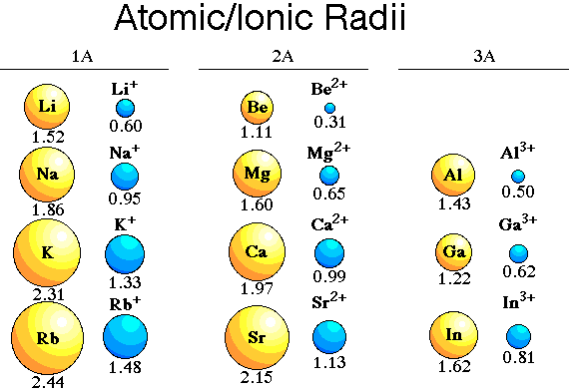
Comparing cation radii to the radii of parent atoms
Radii of neutral atoms

Slide 6
Cation vs. parent atom radii
Cations typically have a SMALLER radius than the parent atom
Why?
Cations have fewer electrons than the parent atoms
Fewer electron-electron repulsions
Fewer occupied energy levels (shells)

Slide 7
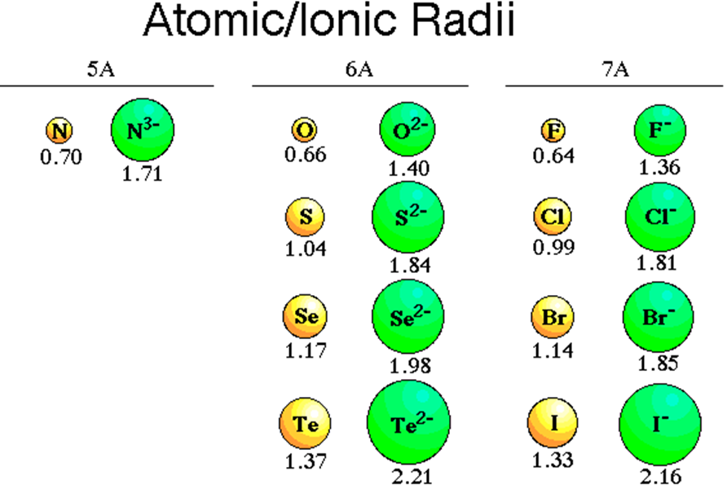
Comparing anion radii to the radii of parent atoms
Radii of neutral atoms

Slide 8
Anion vs. parent atom radii
Anions typically have LARGER radii than the parent atoms
Why?
Anions have more electrons than the parent atoms
More electron-electron repulsions

Slide 9
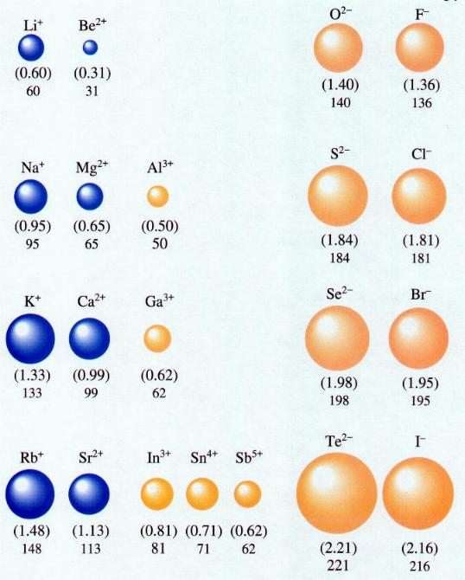
Ionic Radius Trends
Group trend
Ionic radii increase down a column
More occupied energy levels, farther from the nucleus
Outermost electrons have a weaker Coulombic attraction to the nucleus

Slide 10
Ionic Radius Trends
. fill
Period trend (L to R)
Cations get smaller
Then anions get smaller
Nuclear charge increases left to right, filling same energy level
Outermost electrons have a stronger Coulombic attraction to the nucleus

Slide 11



Which of the following would have the larger radius?
Ca or Ca²⁺
P or P³⁻
Ca²⁺ or Cl⁻
Both species have 20 p…Ca has more electrons
Both species have 15 p…P³⁻ has more electrons
They are isoelectronic (both have 18 electrons)
Ca²⁺ has 20 protons vs. 17 protons for Cl⁻

Slide 12



Which of the following would have the larger radius?
K⁺ or Sc³⁺
Cl⁻ or I⁻
P³⁻ or S²⁻
Both species have 18 electrons
K⁺ has 19 protons vs. 21 protons for Sc³⁺
I⁻ has more occupied energy levels than Cl⁻
Both ions have 18 electrons
P³⁻ has 15 protons vs. 16 protons for S²⁻

Slide 13
Summary
Cations have smaller radii than the parent atoms.
Anions have larger radii than the parent atoms.
Group trend: Ionic radii increase down a column
Period trend: Cations get smaller, then anions get smaller
Subscribe to my channel!

